Slide 1
Types of soil pollutants: inorganic, organic and radioactive

Slide 4
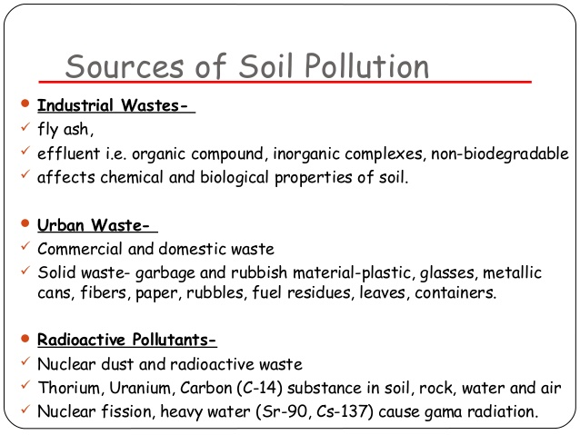

Slide 5
